Slide 1

Research Methodology
Writing and Doing Literature Review
Dr. Arti Arya
Department of Computer Science and Engineering

Slide 2

Research Methodology
Literature Review
Dr. Arti Arya
Department of Computer Science and Engineering

Slide 3
Research Methodology
Disclaimer
These slides are prepared from the prescribed text book and other reliable resources from the Internet.
The images are imported from various sites and videos are imported from youtube.com

Slide 4


Research Methodology
Literature Review ( A quick Review)
A critical analysis of existing research in your field; it highlights both the strengths and weaknesses of existing research
Allows you to gain a critical understanding of your field
Opportunity to think about what has been done in your field; opportunity to think about the similarities, patterns, trends and also differences across the existing research
By identifying strengths and weakness, you will be able to think about what has not/needs to be done in your field
The gap in the literature is your justification for your research

Slide 5

Research Methodology
Much more than just a Chapter in your Project Report or Dissertation
A literature review is a process as well as an outcome!
Literature review as an outcome: appears in the final draft of your thesis as part of your introduction or as a separate chapter.
Literature review as a process: critical engagement (thinking, reading and writing) with relevant research on your topic. It is a crucial and formative stage of your thesis journey.

Slide 6

Research Methodology
Critical Thinking as a Student
Undergraduate level: backing your points up with appropriate, authoritative sources
Masters Level: demonstrating that you understand how knowledge is created
PhD Level: demonstrating that you can create new, original knowledge
Professional academic: peer review, building a coherent body of work of your own and assuring others’ work

Slide 7
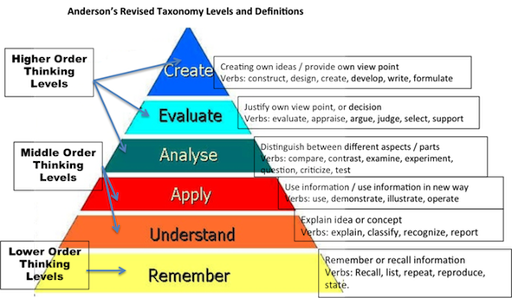

Research Methodology
Why is it so important to write critically?

Slide 8

Research Methodology
Bloom’s Taxonomy
Synthesis/Creation
Evaluation
Analysis
Application
Understanding
Knowledge

Slide 9

Research Methodology
Reading Literature Critically
Think about:
  What were the research aims of the paper/book?
  Is the research aim achieved? If so, how did they do it?
  Are there any problems with their methodology?
  Was it a strong or a weak research model?
  How will this research help with your own research?
  What can you take from it?
  What needs to be avoided?
  What are you doing differently?

Slide 10

Research Methodology
Critical Thinking: A 3-yr-old’s guide
  Why?
  How does that work?
  What’s that made of?
  What’s that for?
  What does that mean?
  But X says…
  How do you know?
  So what?
  Says who?
  What happens if…

Slide 11

Research Methodology
What critical thinking means in terms of Literature Review
Understanding research on its own terms – testing its viability
Understanding research in relation to other arguments
Critiquing research in relation to what you want to do

Slide 12

Research Methodology
Think about your literature review
Who are the key players in my field? This could be anything from academics, medics, governing bodies, schools of thought etc. (Sources!)
What are the main ideas/debates in my field?
How have these ideas changed over time?
What are some of the problems with these ideas/debates? Is there a problem with the methodology?
What are you going to do differently?

Slide 13

Research Methodology
Key Players and Sources
Ask yourself:
What research and theory is there on my topic?
What are the key sources (books, articles) on my topic?
Who are the main theorists and researchers in this area?
How has the topic/problem been investigated over time?

Slide 14


Research Methodology
Literature Review: Where to Start?
YOU DON’T NEED TO READ EVERYTHING – you can’t!
You don’t need to read every text
You don’t need to read every word

Slide 15



Research Methodology
Literature Review: one researcher vs another
Scholar X
Scholar Y
disagrees with
agrees with (school
of thought?)
builds on the conclusions of
confirms the findings of
has reservations about

Slide 16

Research Methodology
Thinking Critically
When identifying the key ideas, themes and methodologies in your field, THINKING CRITICALLY will allow you to identify a ‘gap’ in the literature
Ask yourself:
What are the strengths and weaknesses of these debates?
What evidence is lacking, inconclusive or limited?
What will you add to the topic? What will you do differently?

Slide 17
Research Methodology
Literature Review
What’s your story?

Slide 18

Research Methodology
Thinking about your Literature Review
Map your story (literature review):
What is your topic?
Who are the key people in your field? What are the key resources?
What are the key ideas in your field? What methodologies have been used?
What are some of the strengths and weaknesses of existing research?
What will your contribution be? How will it be different?
(NB: If you can’t answer some of these question, make a note of this. It will come in handy later!)

Slide 19

Research Methodology
Planning how to write Literature Review
Planning is about organising the structure of your literature review (your story will help with this!)
How will you organise the information?
  Chronologically?
  Thematically?
  By trends/approaches/techniques?
  Major debates/controversies?
  Probably a combination of these

Slide 20

Research Methodology
Literature Review

Slide 21
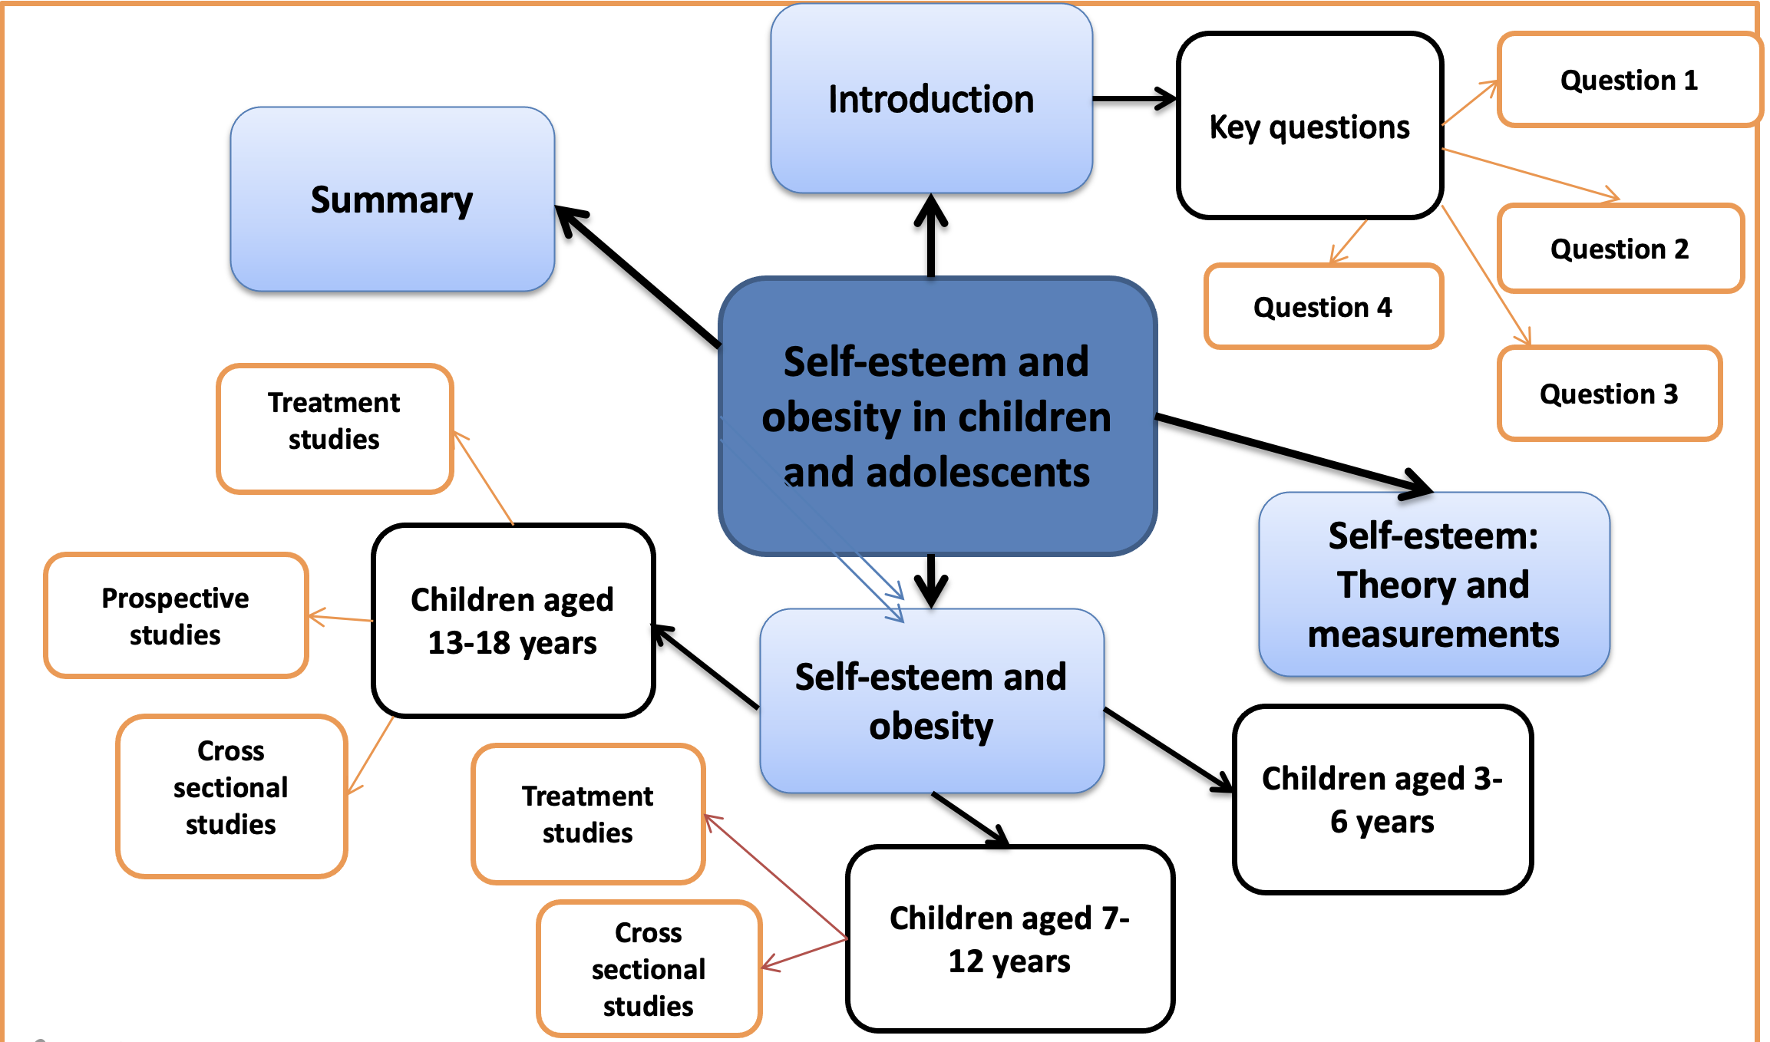

Research Methodology
Literature Review: Self-esteem and obesity in children and adolescents’ mindmap

Slide 22
Research Methodology
Literature Review: Self-esteem and obesity in children and adolescents’ mindmap
A cross-sectional study involves looking at data from a population at one specific point in time.
The participants in this type of study are selected based on particular variables of interest.
Cross-sectional studies are often used in developmental psychology, but this method is also used in many other areas, including social science and education.
Cross-sectional studies are observational in nature and are known as descriptive research,

Slide 23
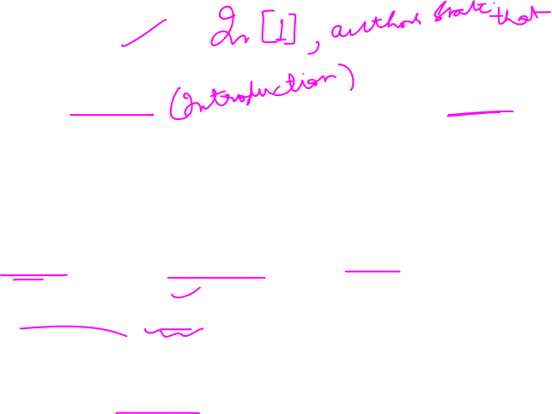
Research Methodology
Writing a Literature Review
Start with an overview
Decide on organising principles (themes, trends, methodology, chronology, controversies – usually a combination of some of these)
Use headings for the different sections of the review
Provide summative signposts of where your argument is leading
Summarise your review/highlight ‘gap’ in research

Slide 24

Research Methodology
Clarity in writing Literature Review
Tips for clear writing:
Clear introduction: overview of topic, aim of review and structure
Clear paragraph structure
Make sure the subject of your sentence is clear
Don’t assume knowledge
Make sure key terminology and difficult ideas are always explained thoroughly (ask your yourself: does it make sense?)
Be objective and balanced
Use signposts to orientate the reader

Slide 25

Research Methodology
Signposting: Your critical views
Where appropriate, begin sections and paragraphs with a statement which synthesises or analyses, rather than just describes
Use signposting words to demonstrate how texts relate to each other and also what you think of them
Eg. However, yet, moreover, indeed, similarly etc

Slide 26

Research Methodology
Use of Citation in Literature Review
A citation is a reference to a source like an article, book, or video.
Citations have several important purposes:
  to uphold intellectual honesty(or avoiding plagiarism ),
  to attribute prior or unoriginal work and ideas to the correct sources
  to allow the reader to determine independently whether the referenced material supports the author's argument in the claimed way.
https://en.wikipedia.org/wiki/Citation

Slide 27

Research Methodology
Importance of Citing Sources
Citing sources is sometimes tedious and challenging, but it is extremely important for a number of reasons:
It makes the paper more credible because it demonstrates that the writer has explored trustworthy sources of information.
It demonstrates respect and appreciation for the work of other writers.
It allows the reader to follow up on any information presented within the paper by locating the original source.
It prevents plagiarism, using someone else's words or ideas without acknowledging their ownership.
https://en.wikipedia.org/wiki/Citation

Slide 28

Research Methodology
Use of Citation in Literature Review
Two types of citations:
Integral: The author’s name appears in the sentence.
  Example (author-date system): Lillis (2001) argues that both tutors and students often lack explicit knowledge of the conventions governing the construction of academic texts.
Non-integral: The author’s name appears outside sentence.
  Example: Both tutors and students often lack explicit knowledge of the conventions governing the construction of academic texts (Lillis, 2001).

Slide 29
Research Methodology
Citation and writer’s voice
Whose voice is dominant - the writer’s or the original author’s?
The moon is made of cheese (Brie 1999).
Brie (1999) argues that the moon is made of cheese.
As Brie (1999) points out, the moon is made of cheese.
According to Brie (1999), the moon is made of cheese. However, ….
Brie (1999) argues out that the moon is made of cheese. However, ….

Slide 30
Research Methodology
Literature Review
Adapted from Dr. Adam Potts slides from New C]astle University

Slide 31
THANK YOU
Dr. Arti Arya
artiarya@pes.edu

